Slide 1
GENCO Investment Strategies by Simulation
Kathleen E. Williams

Slide 2
Presentation
Introduction
Brief Program Overview
Demonstration
Strategies and Scenarios
Q&A Session

Slide 3
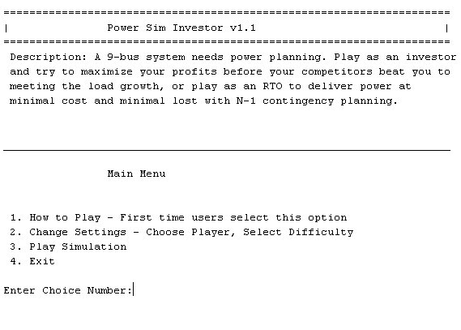
Introduction
What is Power Sim Investor?
Why Did I Do This?
What it does..

Slide 4
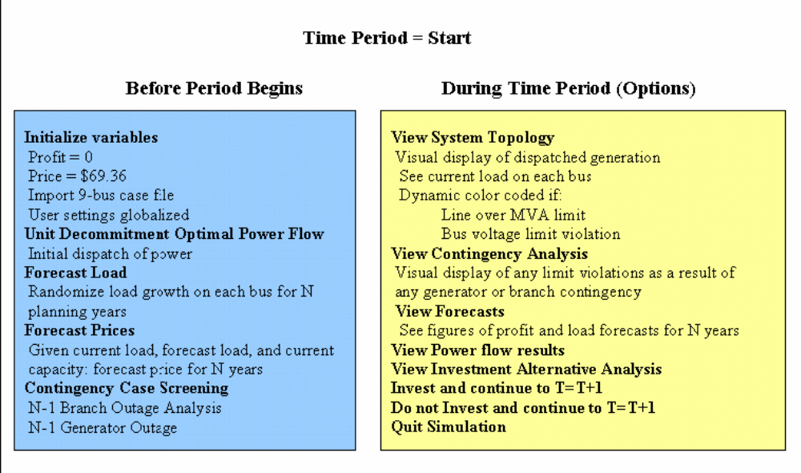
Program Overview

Slide 5
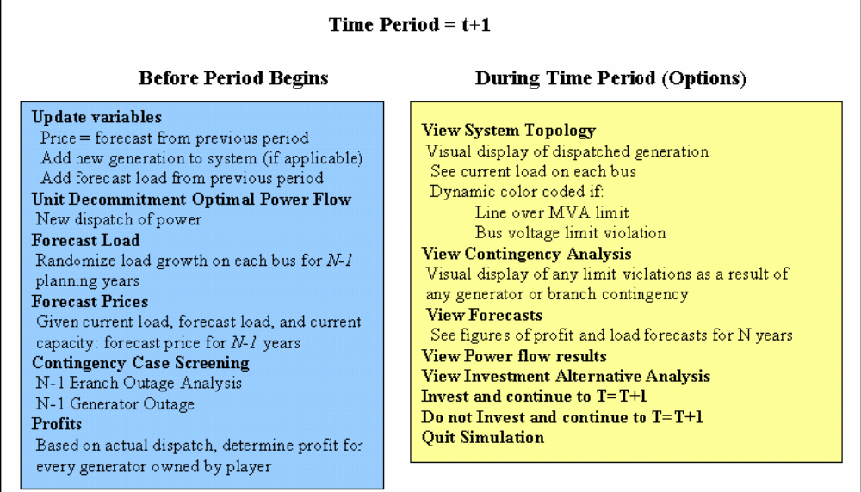
Program Overview

Slide 6
Demonstration
Requirements
• MATLAB Student Version v13 or greater (developed on v14)
• Optimization Toolbox
• Matpower
• Computer running at least 512 MB RAM (1 GB recommended)
To install the program, create a directory in your MATLAB workspace directory called “PowerSimInvestor”. Copy and paste the project files to this directory. Open the MATLAB program and set a path to the “PowerSimInvestor” folder.
On the command prompt type “mainmenu”
>>mainmenu

Slide 7
Strategies and Scenarios
Place generation near load
Always inspect the Investment Alternative Analysis
Net Present Value is not always the best judge of maximum profits
Gas generation is expensive and can cause either windfall profits or heavy losses
Competitors will always be similar to the investor
Competitors will only invest if the market price is above the bidding price
Bidding prices obtain reasonable profits and are above marginal cost
Market prices are based on capacity vs demand
Short-sighted investing can result in massive losses
Load demand does not decrease based on prices but will influence the prices.

Slide 8
Strategies and Scenarios
Coal Company
Player = Coal Company, Competition = High, Load Growth = Low
Player = Coal Company, Competition = Low, Load Growth = Low
Player = Coal Company, Competition = Low, Load Growth = High
Gas Company
Player = Gas Company, Competition = High, Load Growth = Low
Player = Gas Company, Competition = Low, Load Growth = Low
Player = Gas Company, Competition = Low, Load Growth = High

Slide 9
Questions

